Slide 1


Potable Reuse:
Introduction and
Overview of Texas Projects
Texas Innovative Water Seminar
October 12, 2010
Ellen T. McDonald, Ph.D., P.E.
Alan Plummer Associates, Inc.

Slide 2
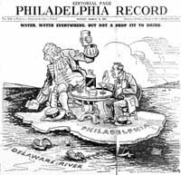
Then
“Water, water everywhere, but not a drop to drink”
Editorial cartoon from the Philadelphia Record, March 14, 1937

Slide 3
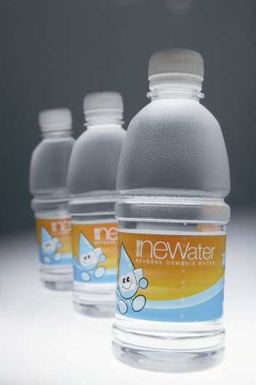
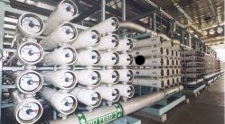
Now
Singapore Public Utilities Board
http://www.pub.gov.sg/newater/

Slide 4

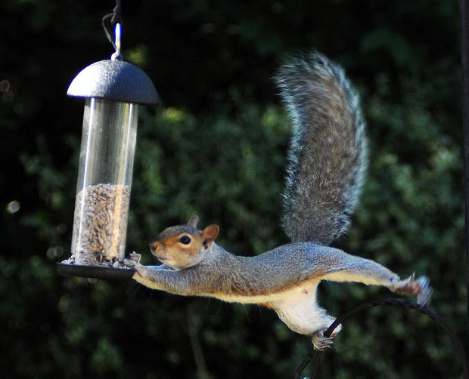
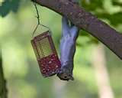
Ongoing Challenges
Public health and safety
Balancing human and ecological needs
Treatment requirements
Public acceptance

Slide 5
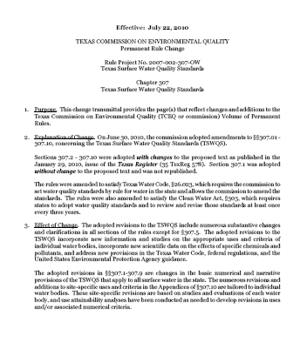
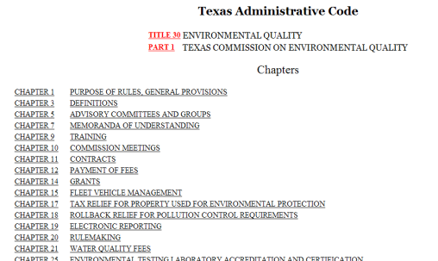
Texas Regulatory Drivers- Indirect Potable Reuse
Surface Water
  Surface Water Quality Standards
  Water rights permitting
Groundwater
  For potable aquifers, injected water must meet drinking water standards

Slide 6
Texas Potable Reuse Projects
El Paso
Tarrant Regional Water District
North Texas Regional Water District
Colorado River Municipal Water District

Slide 7
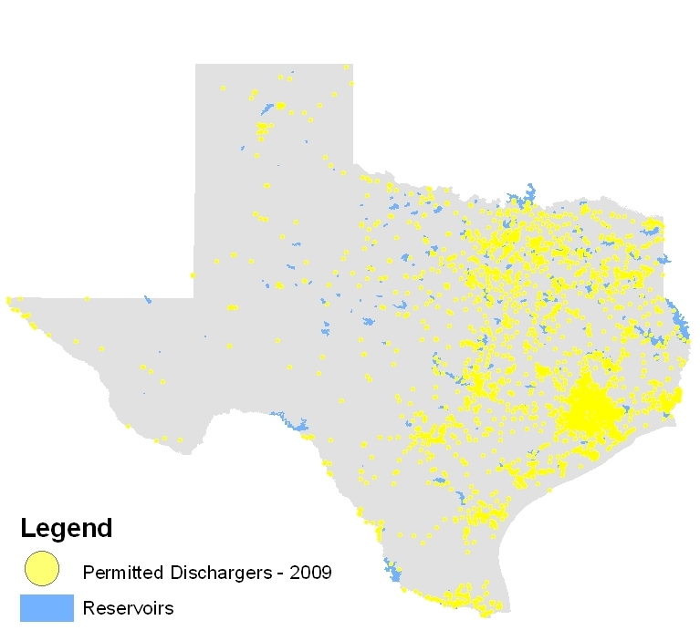
Permitted Discharges-2009

Slide 8
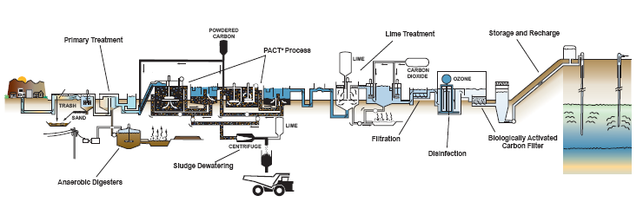
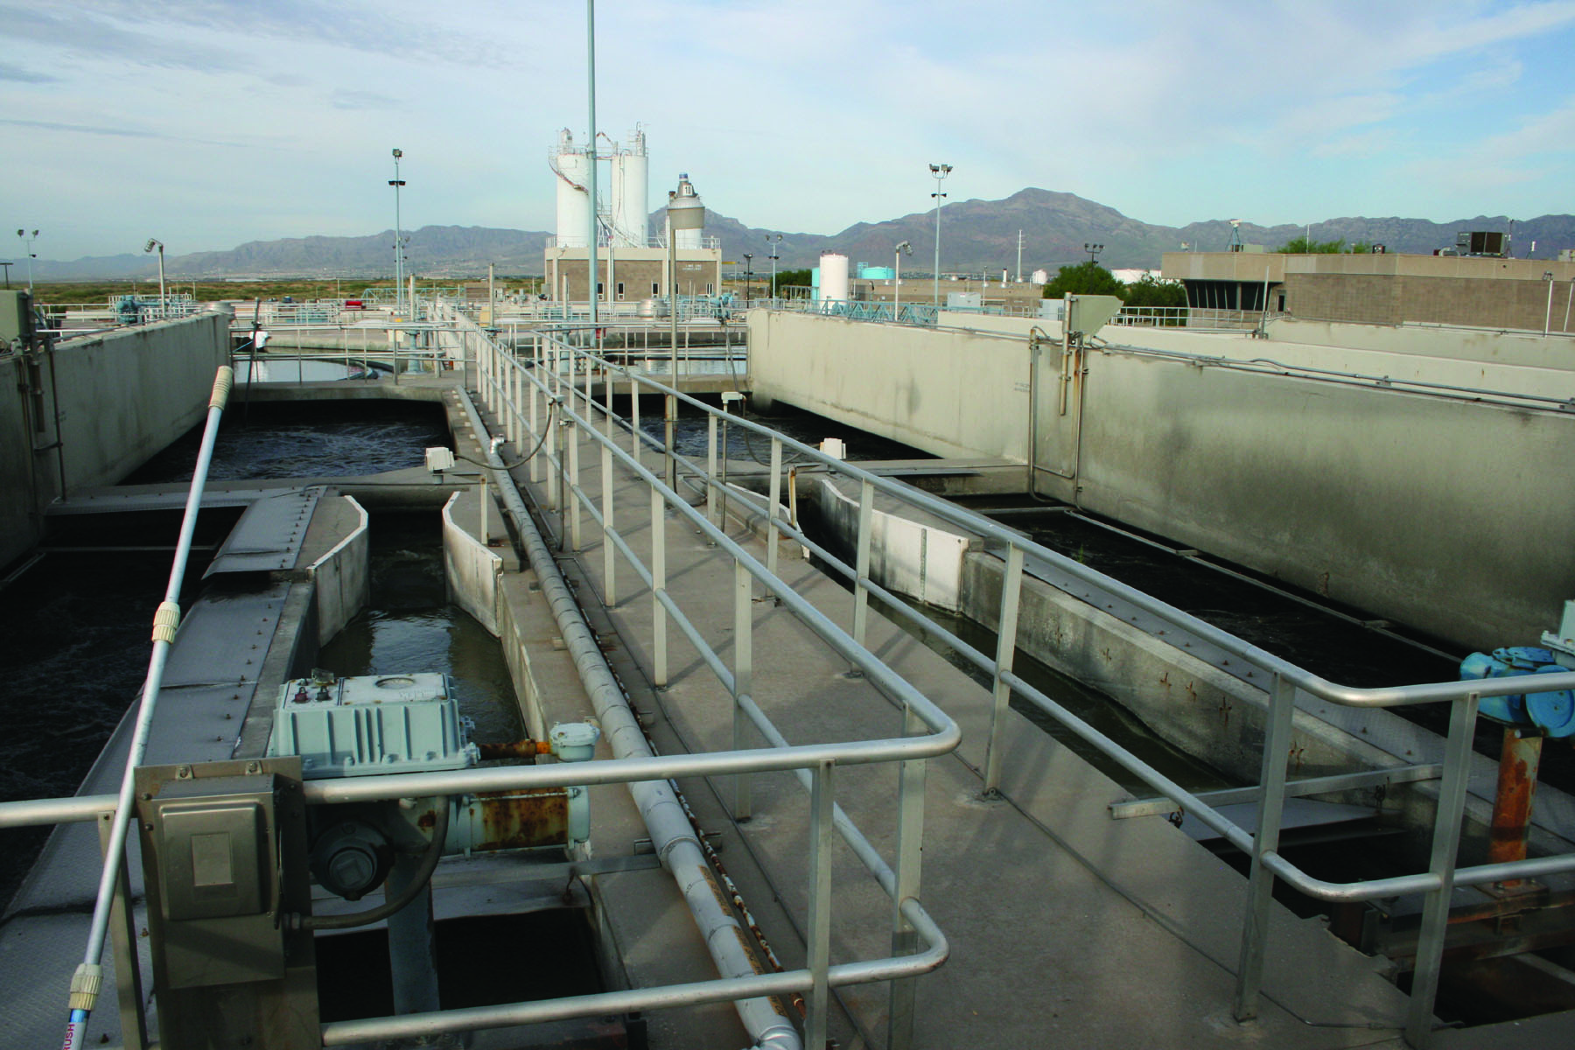
El Paso Water Utilities- Hueco Bolson Recharge Project
Notes:
Fred Hervey plant put in operation in 1985. Current design capacity of 10 MGD. (Being upgraded to 12.2 MGD)

Slide 9
TARRANT REGIONAL WATER DISTRICT
WETLAND REUSE PROJECT
EXISTING SUPPLY
Richland-Chambers
Cedar Creek
Bridgeport
Eagle Mtn.
Benbrook
Arlington
Tarrant Co.
Dallas Co.
Cedar
Creek
Trinity
River
Richland-
Chambers
Phase II Wetland
Current Wetland

Slide 10
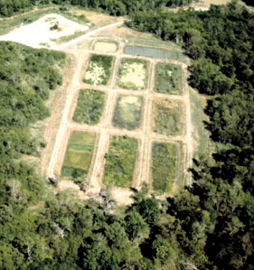
TRWD PILOT-SCALE WETLAND RESEARCH
Site Selection
Flooding Effects
Planting/Harvesting Requirements
Water Management
Bioaccumulation Potential
Long Term Viability
Notes:
Pilot wetland- 2.5 acres

Slide 11
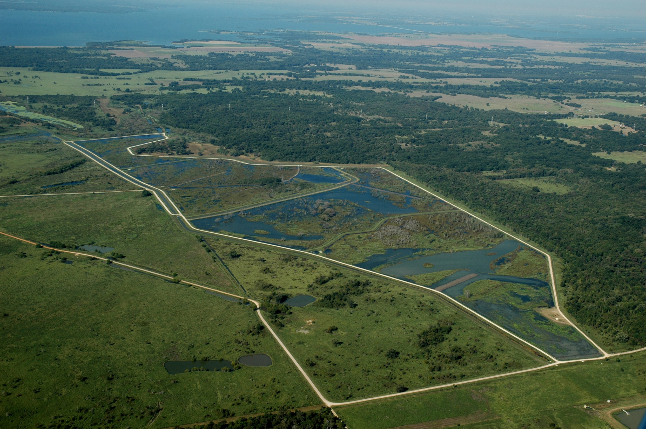
FIELD-SCALE WETLAND

Slide 12
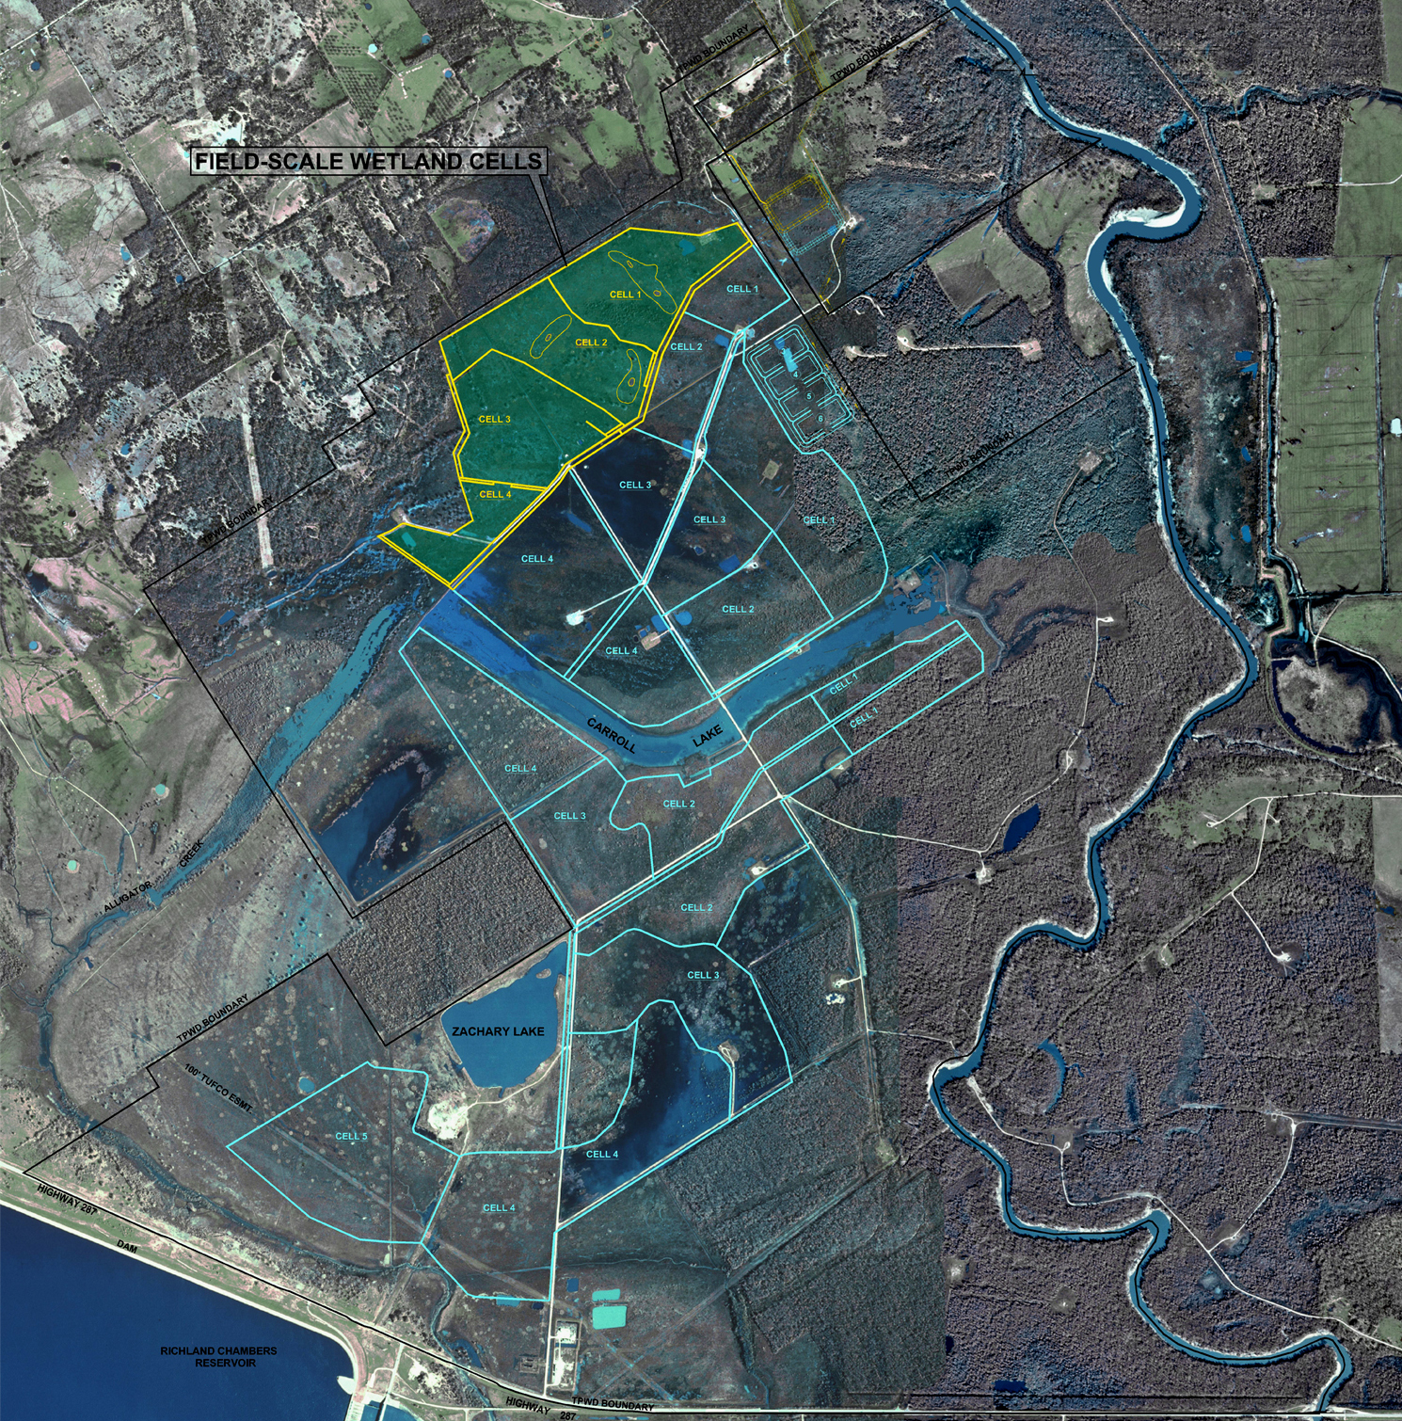
FULL SCALE
PROJECT LAYOUT

Slide 13
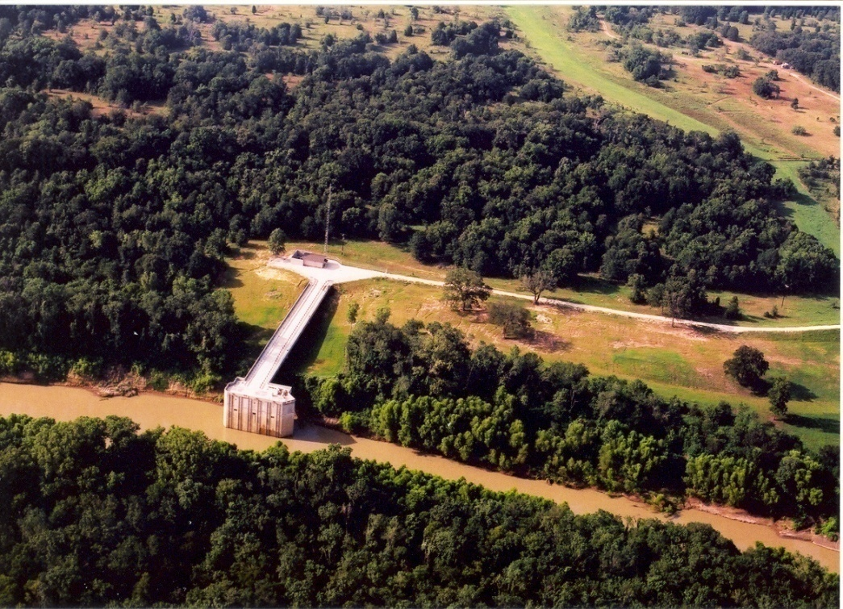
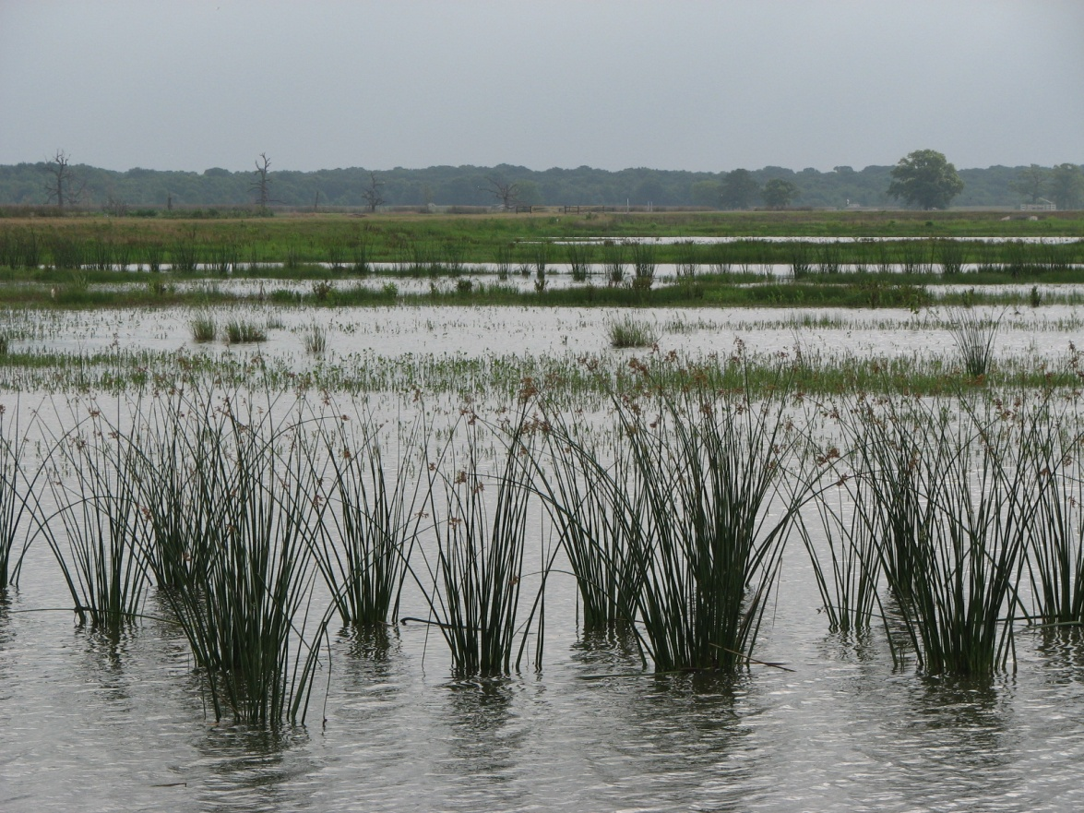
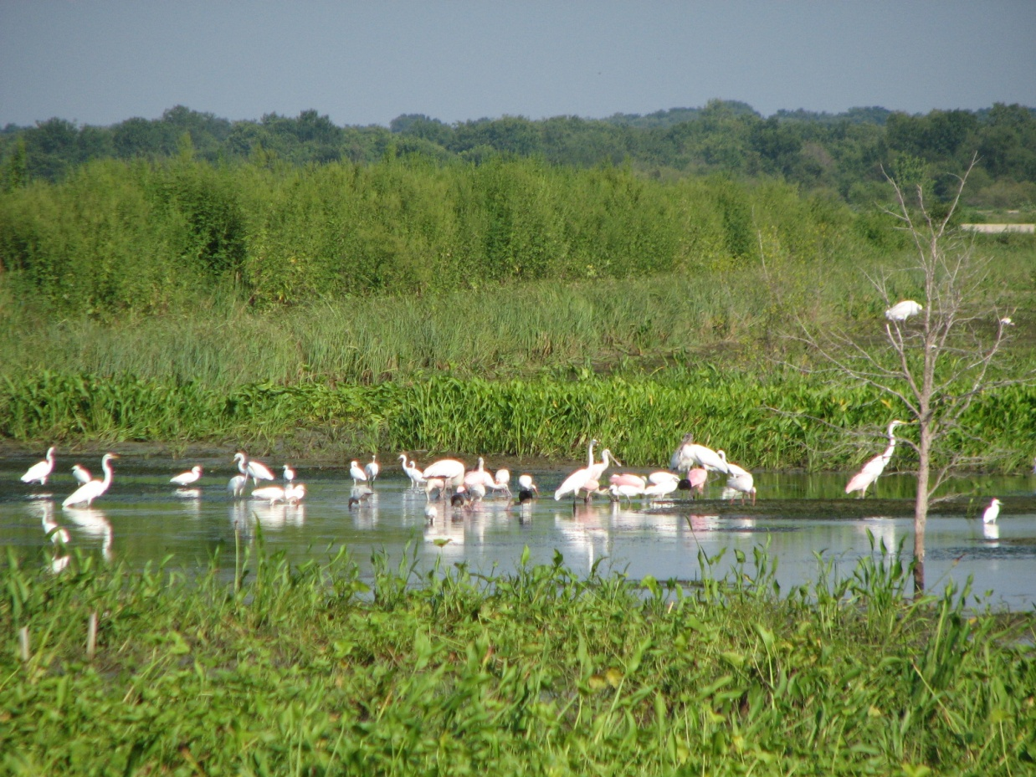
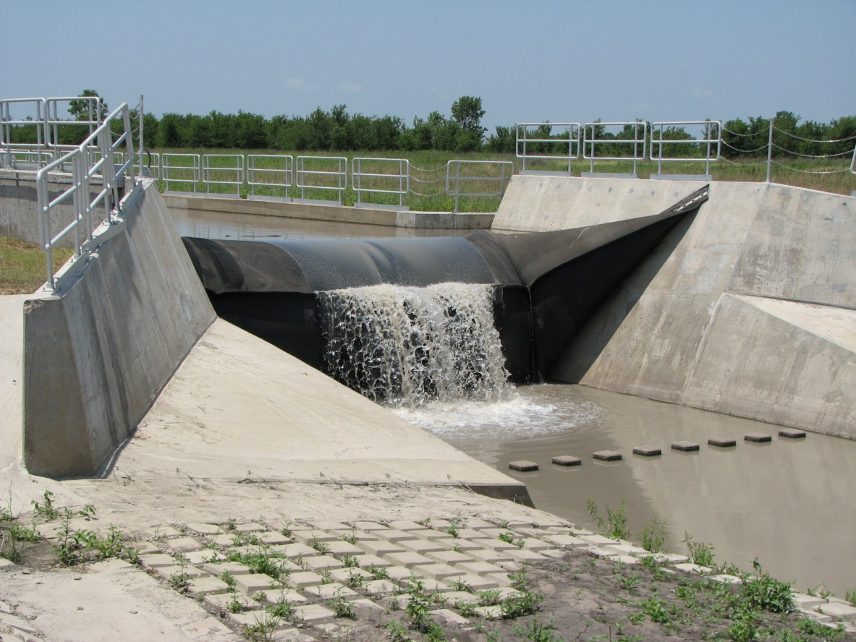

Slide 14
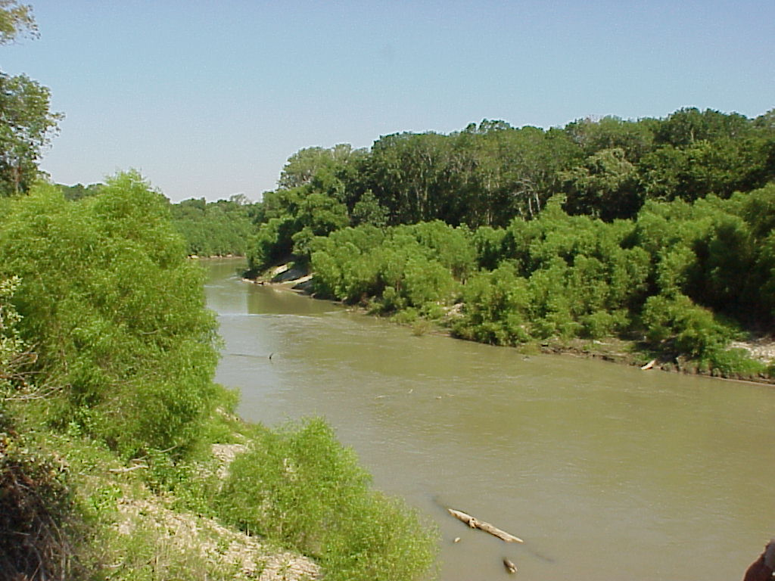
Trinity River
Before Treatment

Slide 15
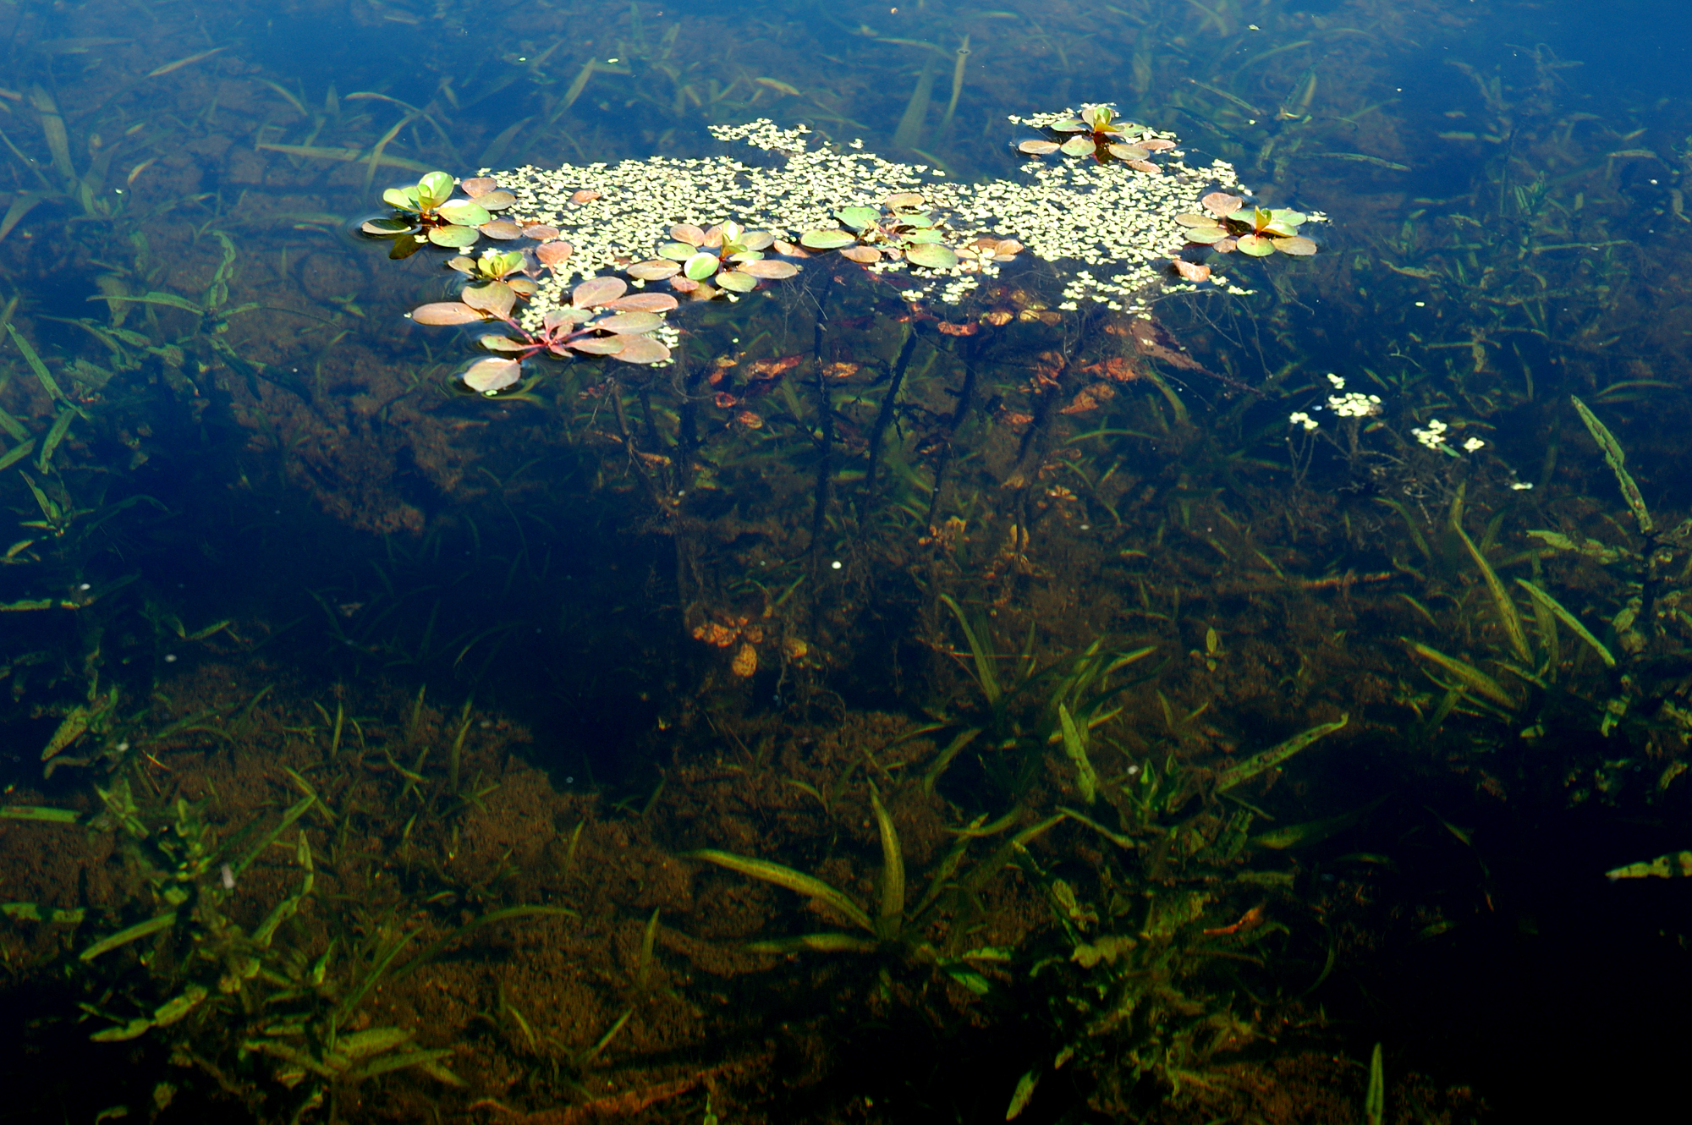
End of Wetland
After Treatment

Slide 16
Lake Texoma Inflow
Chapman Lake Inflow
Lavon
Lake
NTMWD East Fork
Raw Water Supply Project
Wilson Ck
Lake Tawakoni Inflow
Muddy Ck
Rowlett Ck
Lake
Ray
Hubbard
Duck Ck
Major WWTPs
Diversion Point
East Fork Trinity River
Raw Water Transfer
Constructed
Wetland
South Mesquite Ck

Slide 17
Lake Lavon Water Level
Conservation Pool
Drought

Slide 18
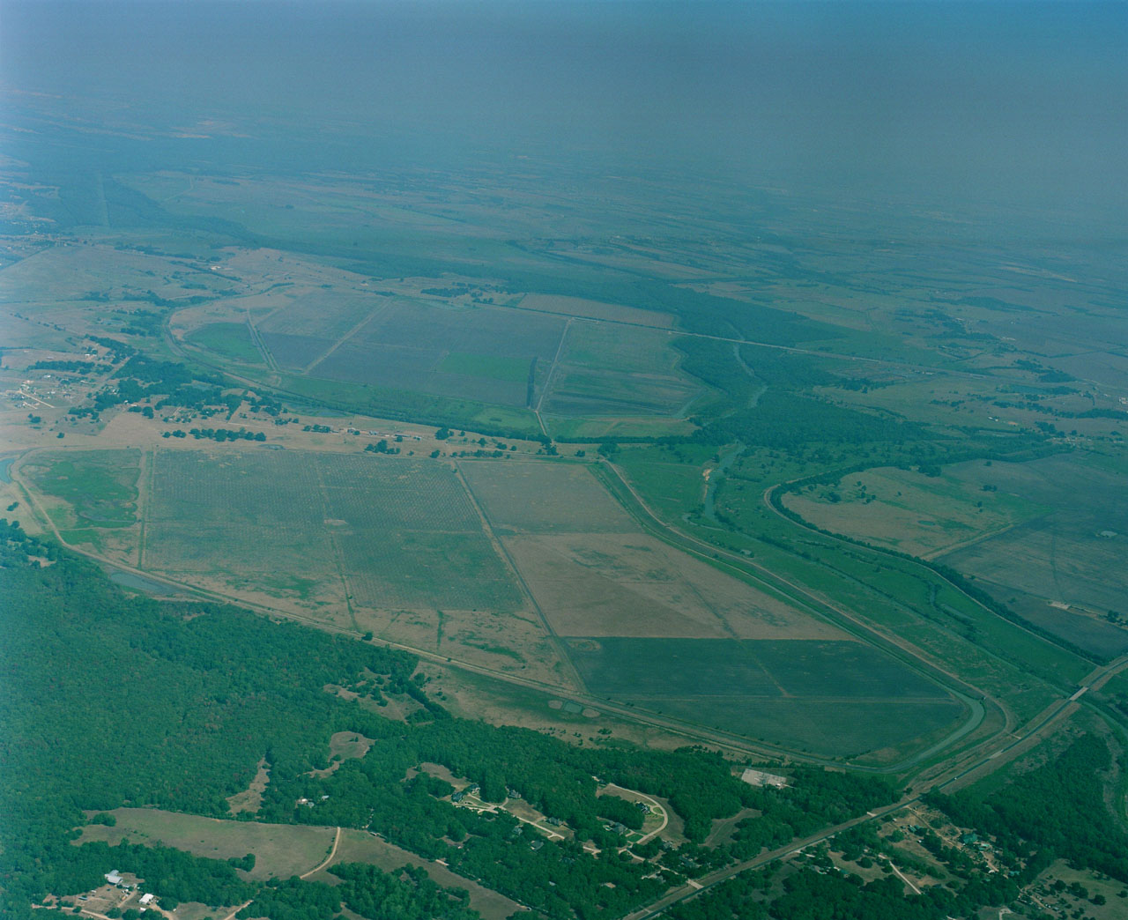
Project Site Characteristics
Wetland easement
(2000 acres)
NORTH
1.4 miles
East Fork
of Trinity
3.7 miles
Direction of flow
Avg. Slope = 0.1%

Slide 19
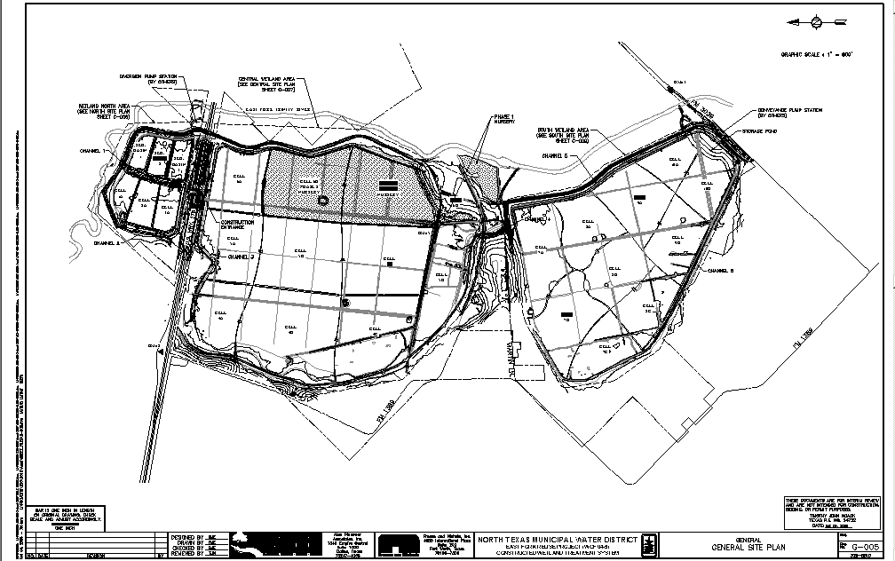
Constructed Wetland
Sedimentation
Basins
Phase 2 Nursery (cells 6B, 6C)
Phase 1 Nursery
Area B
Area A

Slide 20
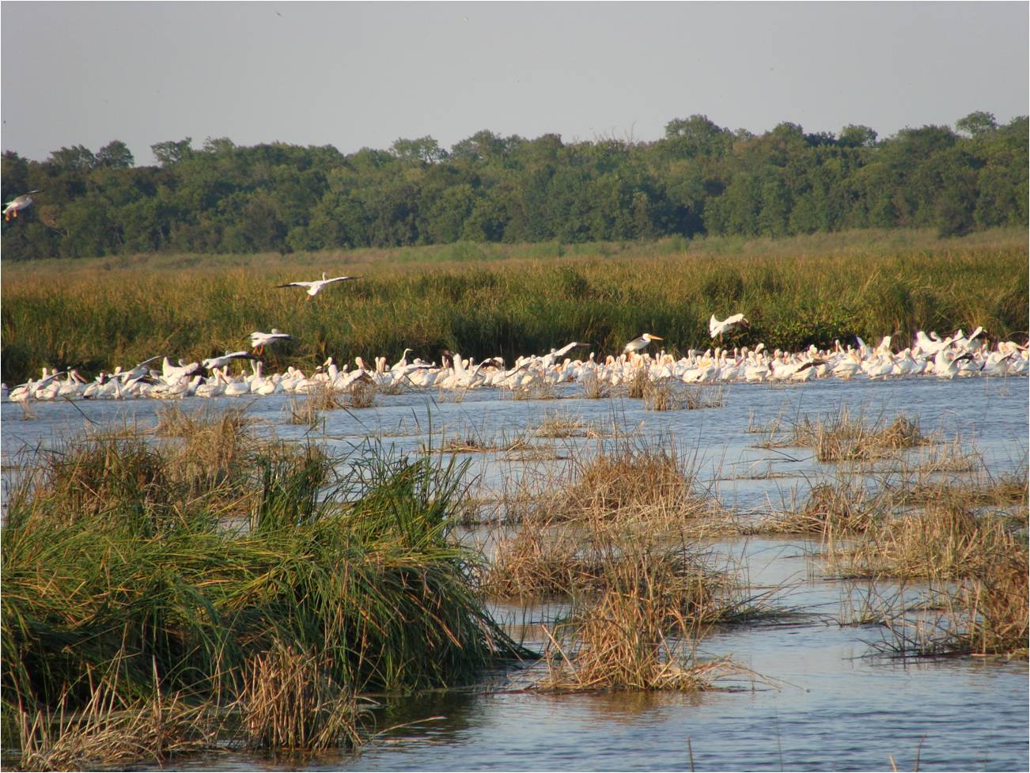
NTMWD Wetland

Slide 21
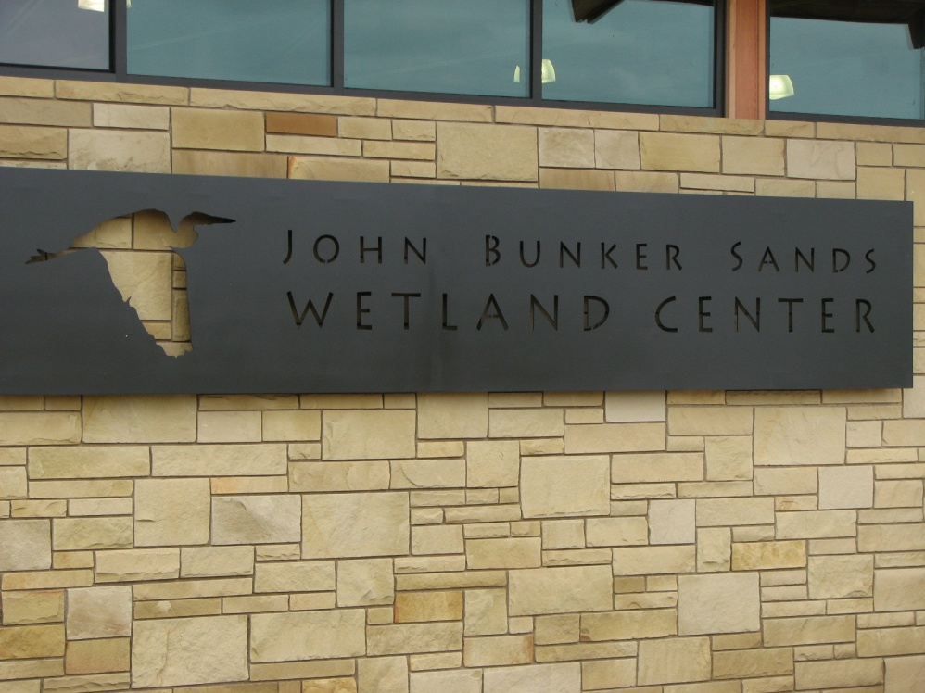
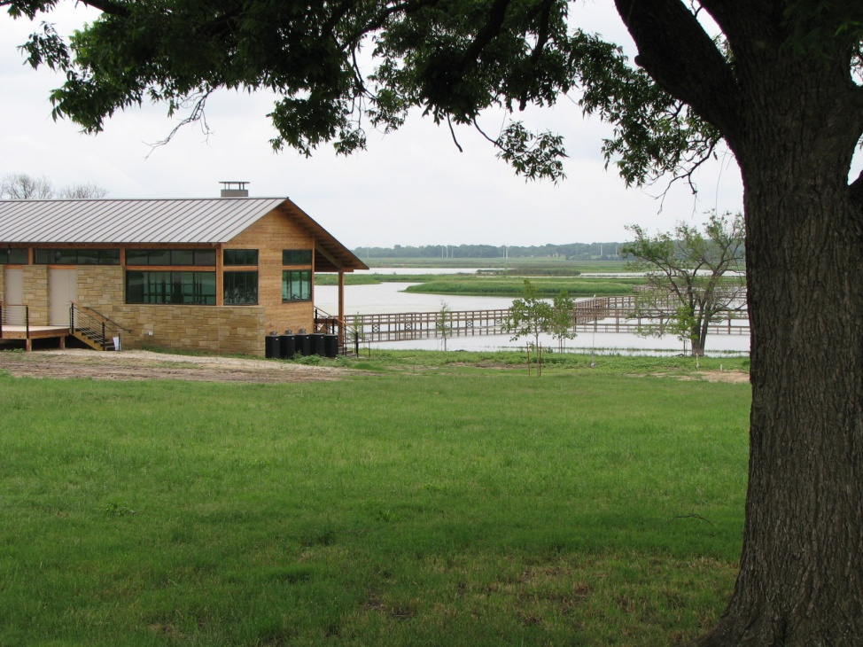
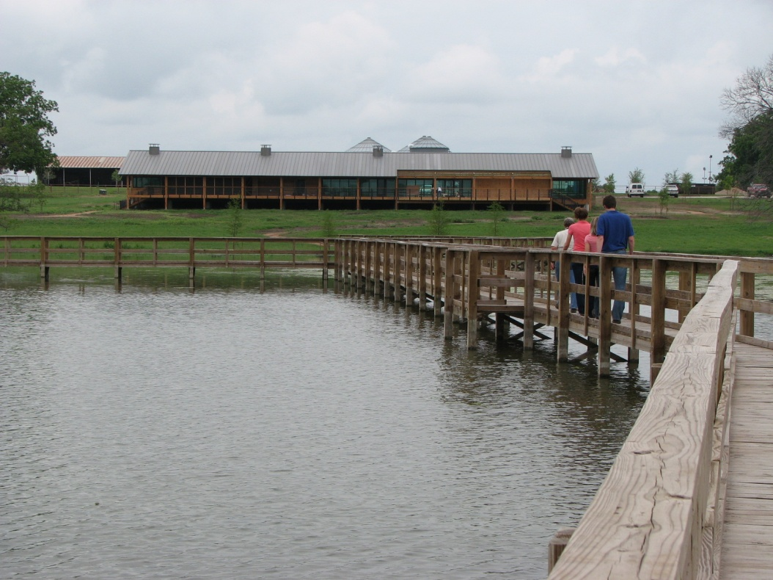
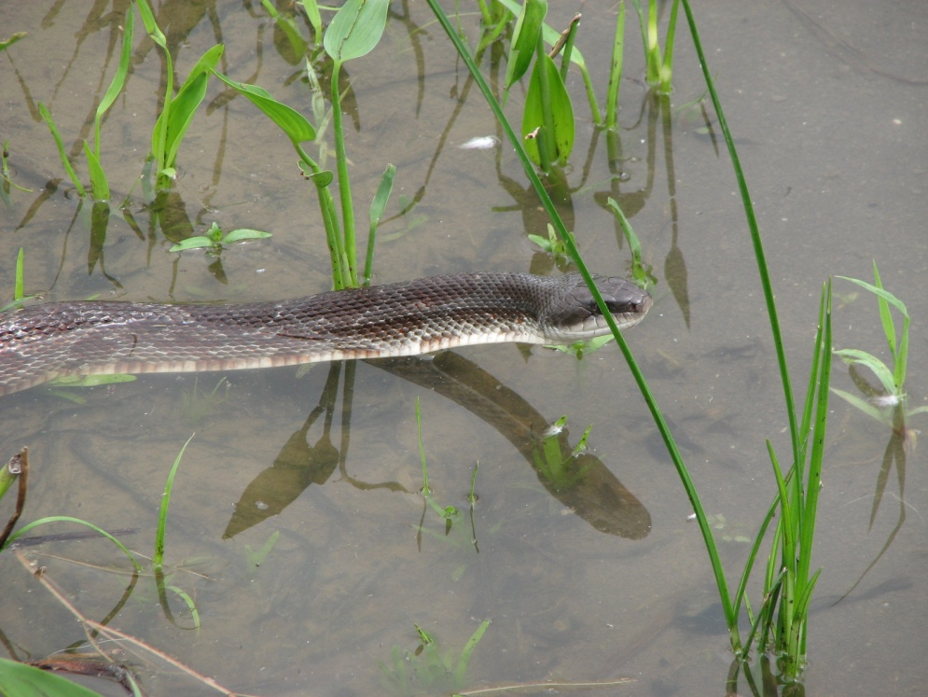

Slide 22
Water Supply Impact
Lake Lavon Yield:
104,000 ac-ft/yr
(93 MGD)
East Fork Water
Supply Project:
102,000 ac-ft/yr
(91 MGD)
+
+
Total Yield: 206,000 ac-ft/yr
(184 MGD)

Slide 23
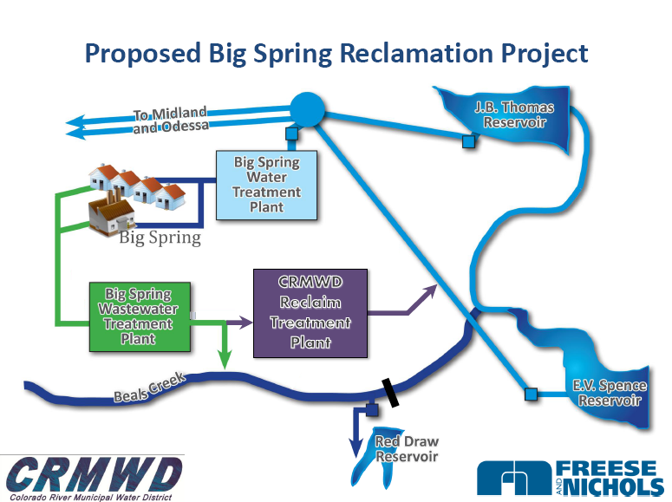

Slide 24
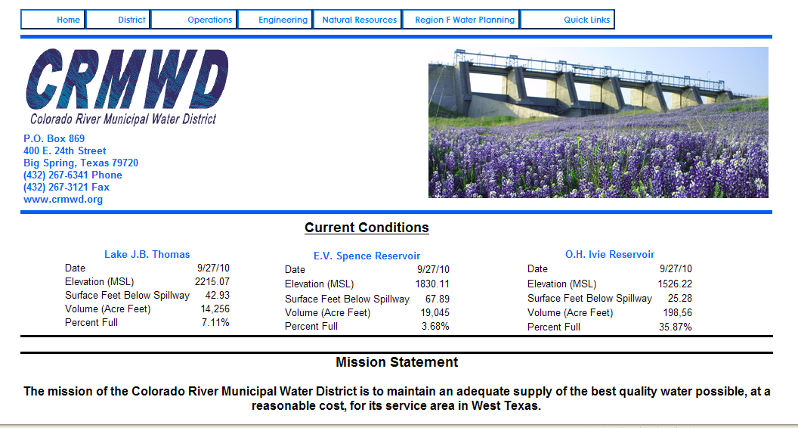
CRMWD
Current Surface Water Supplies
7.1%
3.7%
36%
As of 10/1/10

Slide 25
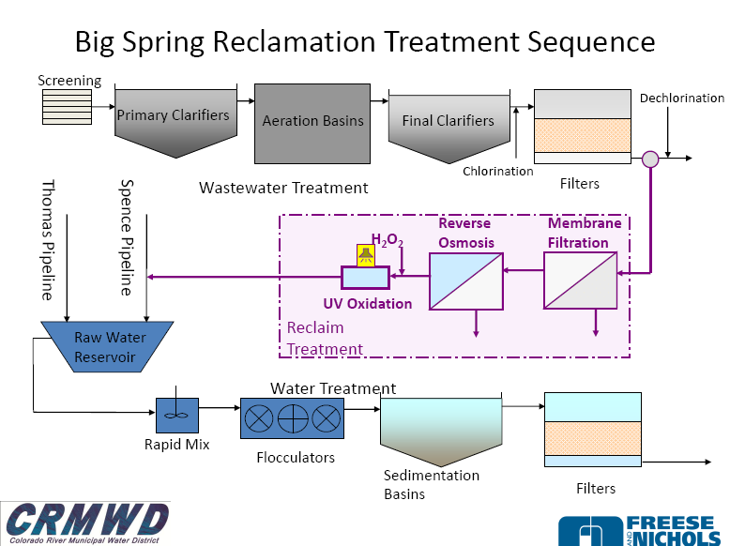

Slide 26
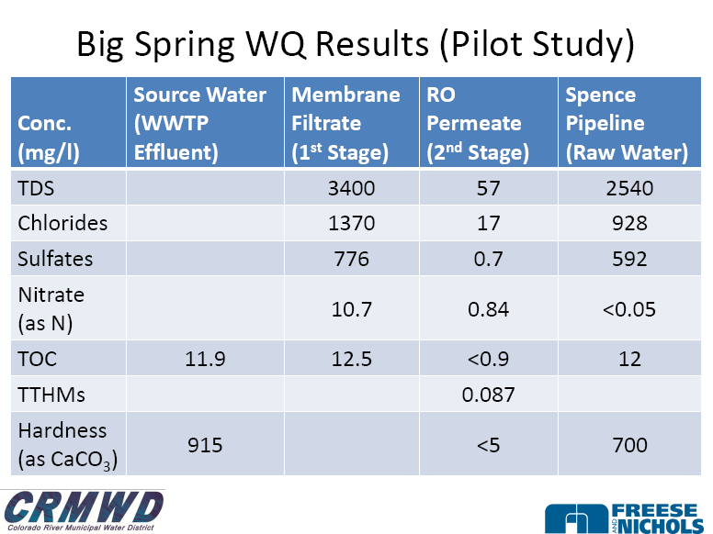

Slide 27

QUESTIONS?
www.funnyanimalsite.com
Ellen McDonald, Ph.D., P.E.
Alan Plummer Associates, Inc
Fort Worth, TX
emcdonald@apaienv.com
817-806-1700

